Slide 1

Digital Electronics and Computer Architecture (DECA)
Digital Electronics (Unit-2):
(Complete Unit)
Digital Electronics: Digital and analog systems, logic levels, duty cycle & pulse waveform, Number Systems (Decimal, Binary, Octal and hexadecimal), Conversion from binary number system to decimal number system and vice versa, 1's Complement and 2's complement, Binary Addition, Subtraction and Multiplication, Boolean algebra - Laws of Boolean algebra. Logic Gates, Basic gates, Universal Gates and special purpose gates with their truth table, symbols, logical expression, K-Map (upto 4 variables), Encoders and Decoders, Multiplexers and Demultiplexers, Basic Latches and Flip- Flops with truth tables.
B.E.-CSE 1st Sem.
Department of Interdisciplinary Courses in Engineering (DICE)
&
Department of Computer Science and Engineering

Slide 2
Signal
A signal is function that represents the variation of a physical quantity to any parameter.
Example: Human speech, voltage, current
The signal can be classified into analog or digital signal
Analog Signal: The amplitude of an analog signal can have any value (including fractions) at any point in time. That means analog signal have infinite values.
Digital Signal: The digital signal’s amplitude can only have finite and discrete values.
The special case of Digital signal having two discrete values is known as Binary signal. However, the number of values for amplitude in a digital signal is not limited to only two.

Slide 3
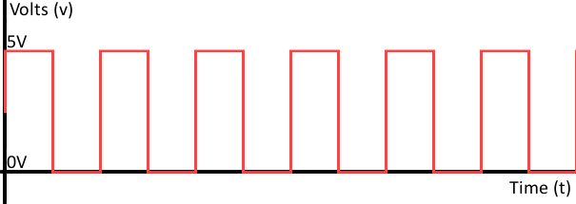
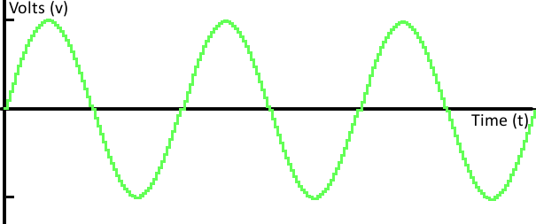
Analog Signal Vs Digital Signal Representation
Digital Signal: The digital signal’s amplitude can only have finite values.
Analog Signal: The amplitude of an analog signal can have any value (including fractions) at any point in time. That means analog signal have infinite values.
The signal can be classified into analog or digital categories base on their amplitude. This classification is based on only vertical axis (amplitude) of the signal. And it does not have any relation with horizontal-axis (time axis).
The signal can be classified into Continuous or discreate categories base on their time. This classification is based on only horizontal axis (amplitude) of the signal. And it does not have any relation with vertical axis -axis (time axis).

Slide 4
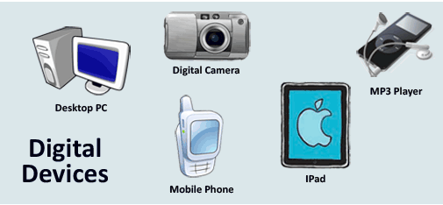
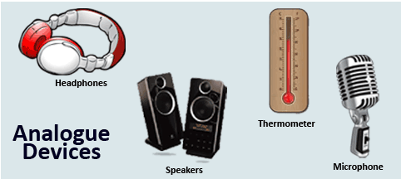
Analog & Digital Devices

Slide 5
What is Digital Electronics?
Digital Electronics is the branch of electronics that deals with digital data in the form of codes. There are only two codes in digital electronics , and they are 0 and 1. 0 is considered to be low logic while 1 is considered to be high logic..
Digital stand for digit, digital electronics basically has two conditions which are possible, 0 (low logic) and 1 (high logic).
"1" as true and "0" as false are called bit and the group of bits are named byte.
Digital electronic circuits are usually made from large assemblies of logic gates.
Digital describes electronic technology that generates, stores, and processes data in terms of two states: 1 and number 0.

Slide 6
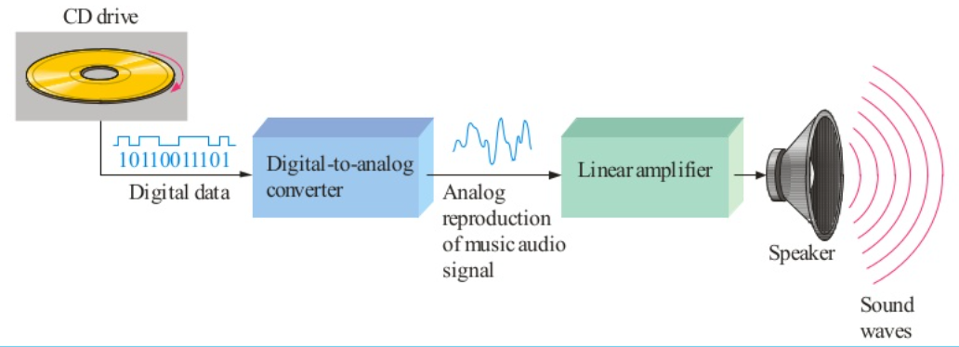
Analog Vs Digital
Many systems use a maximum of analog and digital electronics to take advantage of each technology. Example: A typical CD player accepts digital data from the CD drive and converts it to an analog signal for amplification.
Figure: Example Analog vs digital

Slide 7
Advantages of Digital Electronics
The main advantages of Digital signals are cleared from following points:
1. Digital data can be processed and transmitted more efficiently and reliably than analog data.
2. Digital devices deal with two states like HIGH or 1 and LOW or 0. So this system is very simple and accurate.
3. Digital signals have a great advantage when storage is necessary e.g. music when converted to digital form can be stored more compactly and output show great accuracy and clarity than analog form.
4. Noise (unwanted voltage fluctuations) does not affect digital data nearly as much as it does analog signals.
5. The display of data is more easier to read in digital system than the display of analog system. For example Analog multimeter and Digital multimeter.
6. Digital Signals have high degree of security of data and this advantage has great importance in military operation.
7. The size of Digital device is very small due to Digital ICs and these ICs are very cheap. Digital clock, calculator and semiconductor memories etc. are example of Digital electronics devices used by nearly everyone.

Slide 8
Disadvantages of Digital Electronics
Conversion to digital format and re-conversion to analog format is needed, which always include the lost of information.
Digital circuits consumes more energy than analog circuits and produce more heat and need heat sinks.
Digital circuits are sometimes more expensive, especially in small quantities.

Slide 9
Applications of Digital Electronics
It's application are infinite, ranging for high end computing to miniature circuits that can be very versatile, signal processing, communication etc. Digital Electronics is currently rapidly developing and removing conventional analogue machines due to its high speed, more accuracy and greater flexibility
Digital circuits are a part of all-important electronic devices.
It can be used for designing the display of your watch or a countdown timer.
We use digital circuits in complex processes like Rocket Science and Quantum Computing.
Digital circuits are also used in traffic lights and automatic glass doors in offices and restaurants.

Slide 10
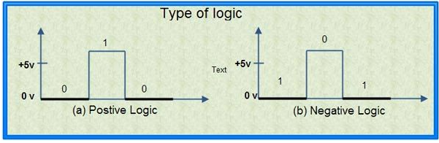
Logic Levels
Logic Voltage Levels: Digital signals are represented by the two voltage levels which are referred to as logic voltage levels. A level logic is a logic in which the voltage levels represent logic 1 or logic O. There are two types of logics.
1. Positive Logic
2. Negative Logic
A positive logic system is the one in which higher of the two voltage levels represents the logic 1 and lower of the two voltage levels represents the logic O. A negative logic system is the one in which the lower of the two voltage levels represents the logic 1 and. the higher of the two voltage levels represent the logic O. So if two voltage levels are OV and +5V, then in the positive logic system, the OV represents a logic ‘0’ and the +5V represents a logic ‘1’. In negative logic system, it is the reverse, OV represents a logic’ l’ and +5V represents a logic ‘0’, (see in fig)

Slide 11
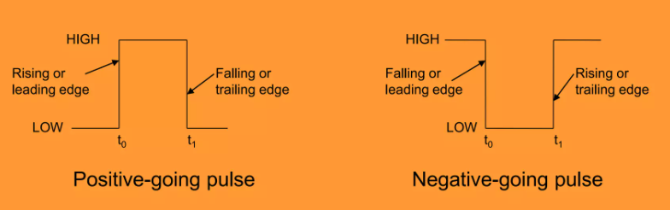
Digital Waveforms
Consist of voltage levels that change back and forth between the HIGH and LOW states- Positive-going pulse.
generated when the voltage goes from LOW level to HIGH level and back to LOW level- Negative-going pulse.
generated when the G voltage goes from HIGH level to LOW level and back to HIGH level.
A digital wave from is made-up of a series of pulses.

Slide 12
Digital Waveforms
Pulse characteristics
Leading edge (occurs first at t = 0)
Trailing edge (occurs last at t = 1)
Positive-going pulse: Leading edge is a rising edge and trailing edge is falling edge
Negative-going pulse: Leading edged is falling edge and trailing edge is rising edge

Slide 13
Digital Waveforms
Waveform characteristics
Most waveforms are composed of a series of pulses (pulse trains)
Pulses can be either - periodic - repeats itself at a fixed interval called a period (T)).
>> The frequency, f, is the rate at which it repeats itself and is measured in Hertz (H)
- non-periodic - does not repeat itself at fixed intervals and may be composed of pulses of different pulse widths.
• Frequency of a pulse, f, is the reciprocal of its . period, T.
f = 1/T
T=1/f
• Duty cycle - the ratio of the pulse width (tw) to the period (T), expressed as a percentage
- Duty Cycle = (tw/T)x100%

Slide 14
Types of Number Systems:- 1. Decimal 2. Binary 3. Octal 4.Hexadecimal
Number System
A number system defines how a number can be represented using distinct symbols.
A number can be represented differently in different systems.
For example: the two number (2A)₁₆ and (52)₈ both refer to the same quantity,
and (42)₁₀ ,but their representations are different.
Radix or Base :- Each number set is defined with particular digits or bits.

Slide 15
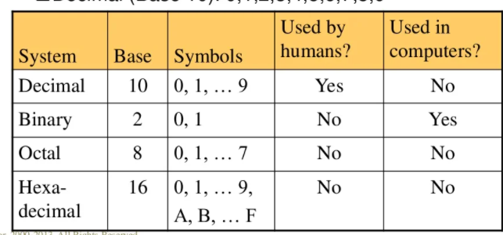
Common Number System

Slide 16
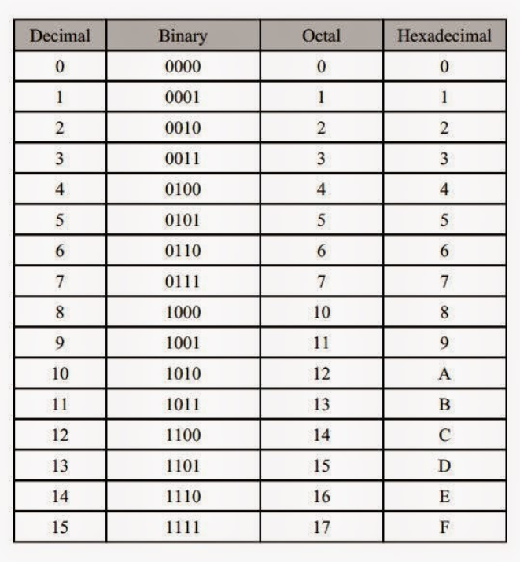
Decimal, Binary, Octal and Hexa-decimal

Slide 17
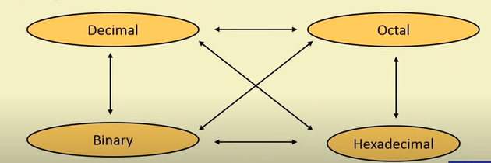
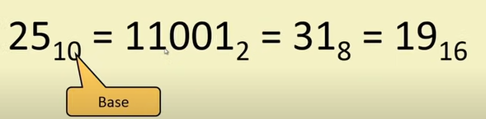
Conversion possibilities

Slide 18
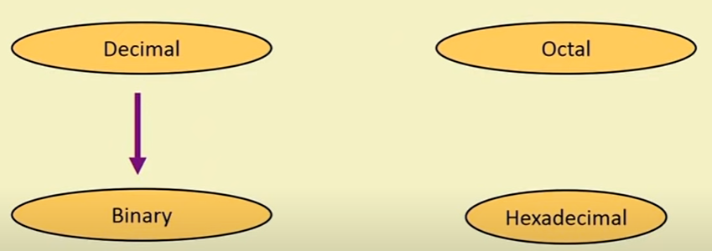
Decimal to Binary

Slide 19
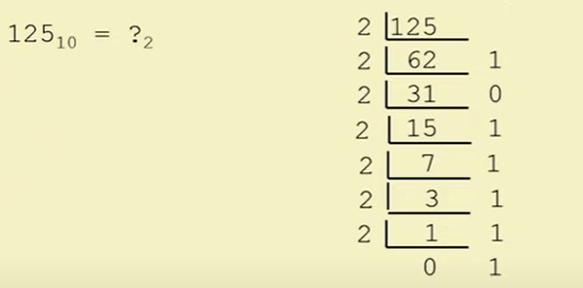
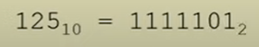
Decimal to Binary
Divide by two, keep track of the remainder
Example:

Slide 20
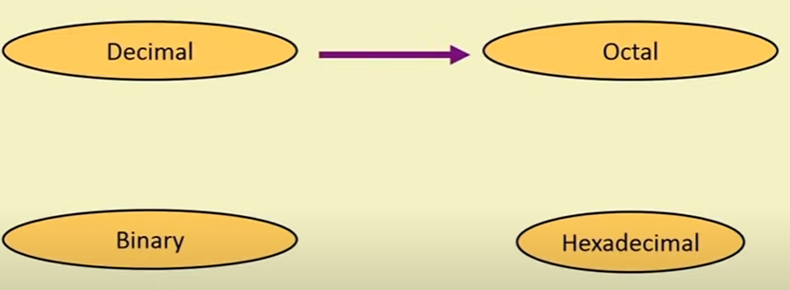
Decimal to Octal

Slide 21
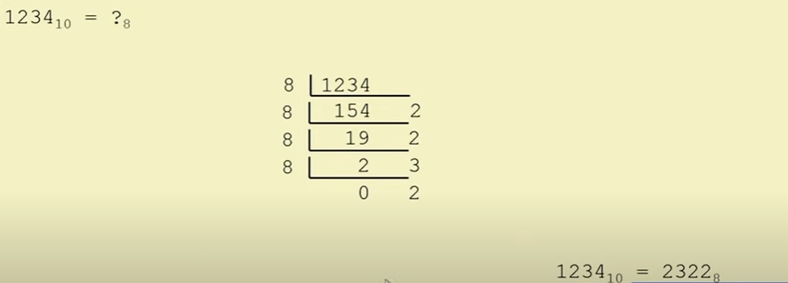
Decimal to Octal
Divide by 8
Keep track of the remainder
Example:

Slide 22
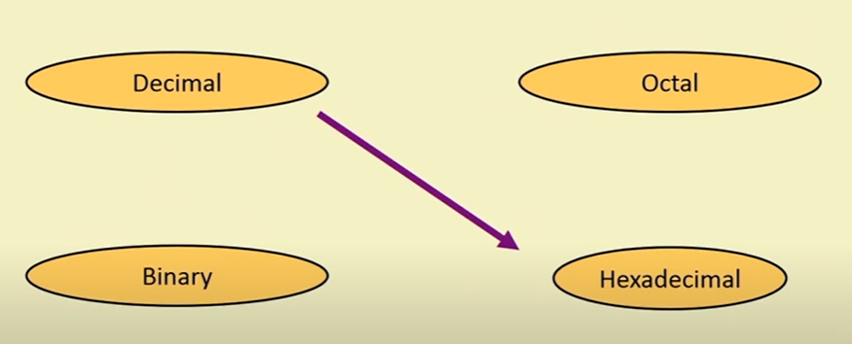
Decimal to Hexadecimal

Slide 23
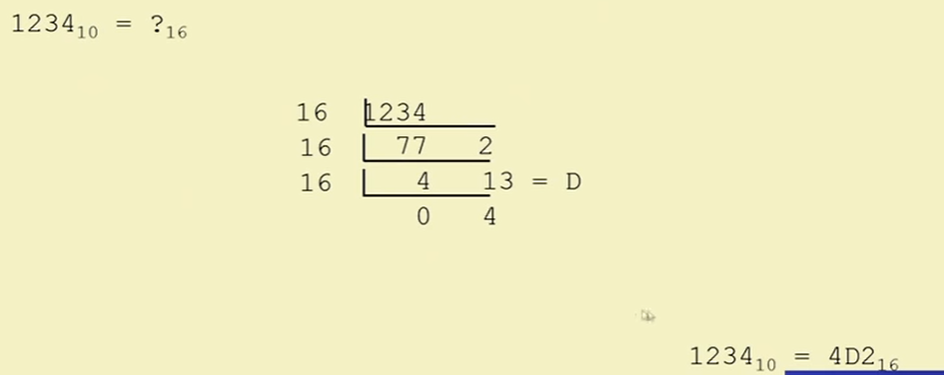
Decimal to Hexadecimal
Divide by 16
Keep track of the remainder
Example:

Slide 24
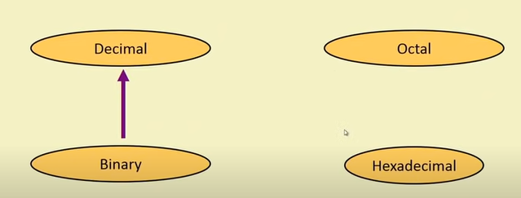
Binary to Decimal

Slide 25
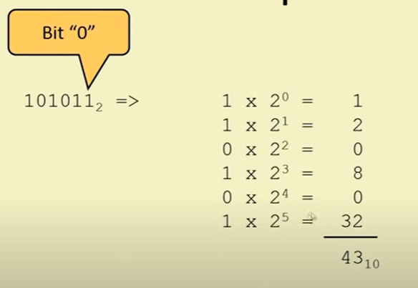
Binary to Decimal
Multiply each bit by 2 , where n is the "weight" of the bit
The weight is the position of the bit, starting from 0 on the right
Add the results.
Example:
n

Slide 26
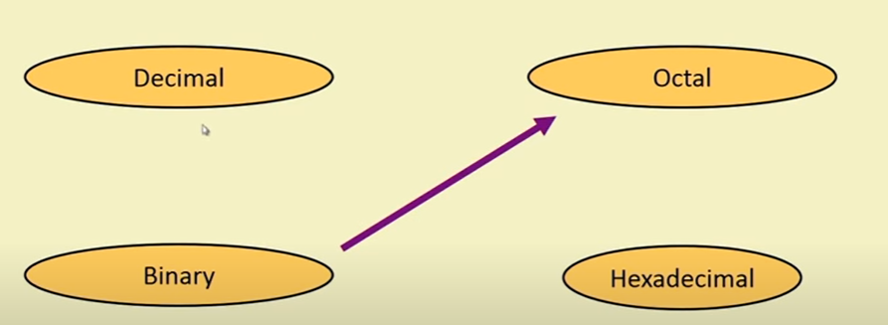
Binary to Octal

Slide 27
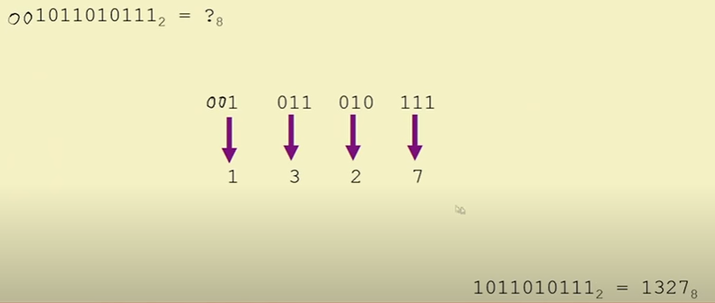
Binary to Octal
Group bits in three, starting from the right
Convert it to octal digits

Slide 28
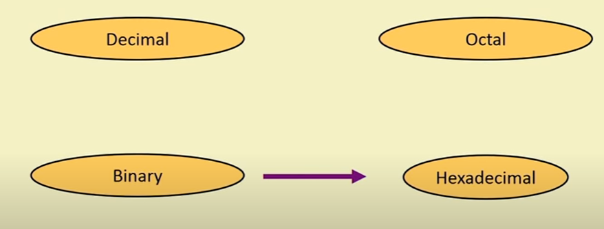
Binary to Hexadecimal

Slide 29
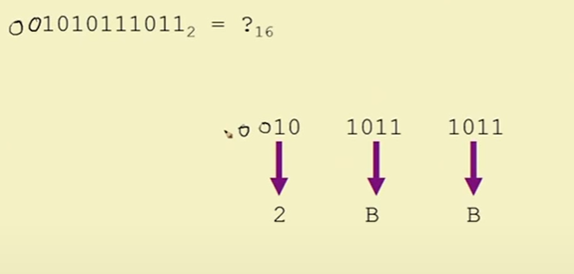
Binary to Hexadecimal
Group bits in four, starting from the right
Convert it to Hexadecimal digits

Slide 30
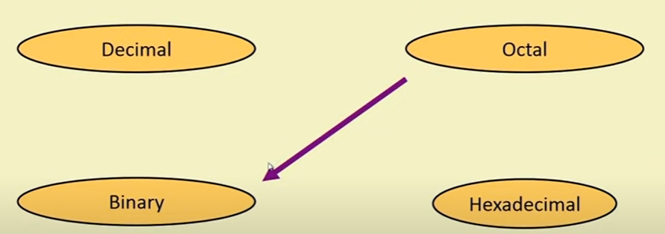
Octal to Binary

Slide 31
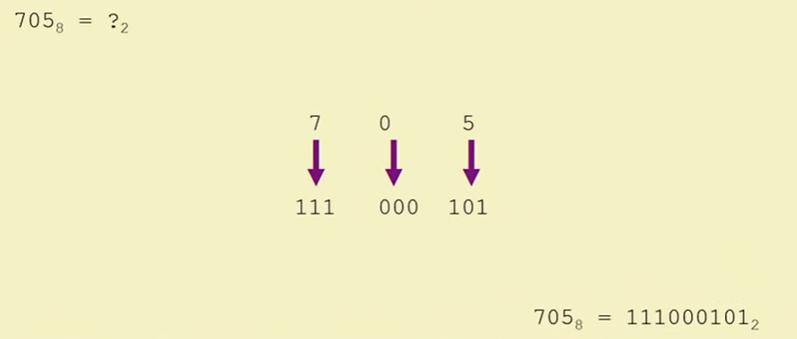
Octal to Binary
Convert each octal digit to a 3-bit equivalent binary representation
Example

Slide 32
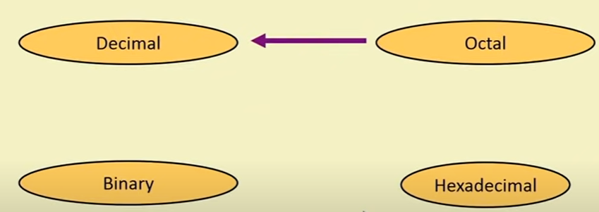
Octal to Decimal

Slide 33
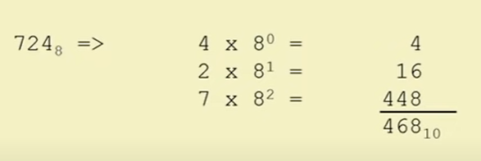
Octal to Decimal
Multiply each bit by 8 , where n is the "weight" of the bit
The weight is the position of the bit, starting from 0 on the right
Add the results.
Example:
n

Slide 34
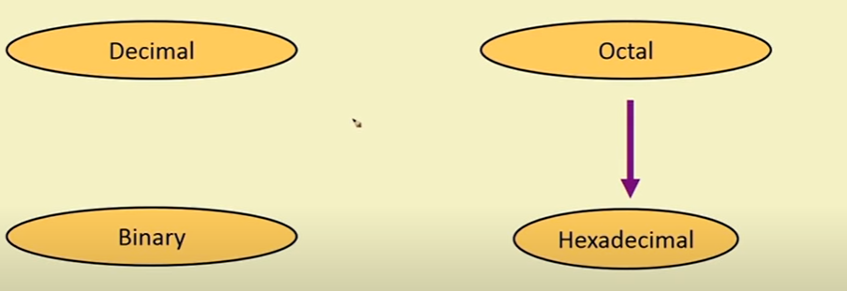
Octal to Hexadecimal

Slide 35
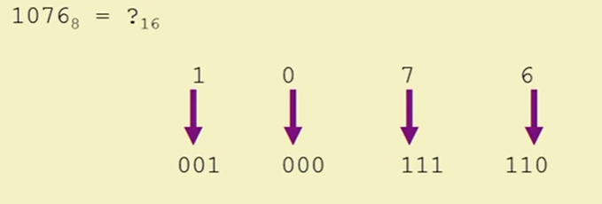
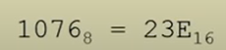
Octal to Hexadecimal
Use binary as intermediary

Slide 36
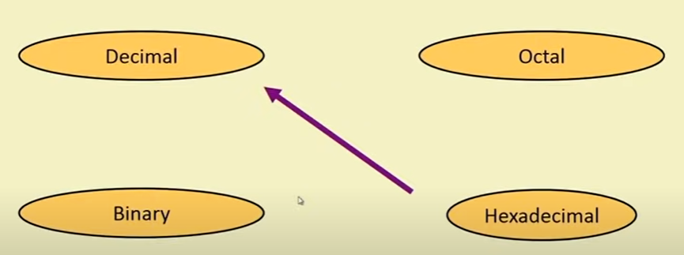
Hexadecimal to Decimal

Slide 37
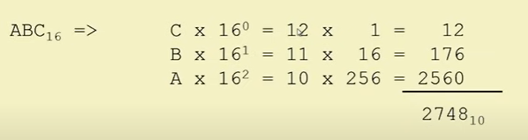
Hexadecimal to Decimal
Multiply each bit by 16 , where n is the "weight" of the bit
The weight is the position of the bit, starting from 0 on the right
Add the results.
Example:
n

Slide 38
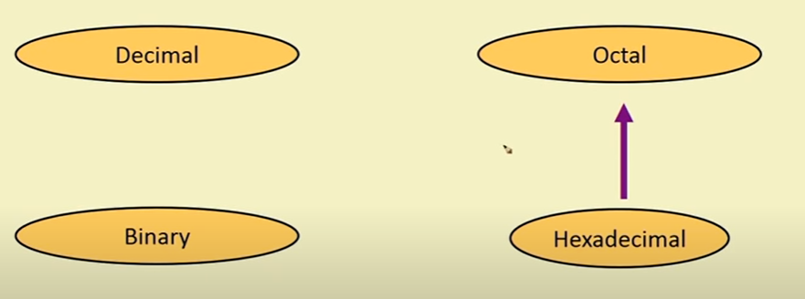
Hexadecimal to Octal

Slide 39
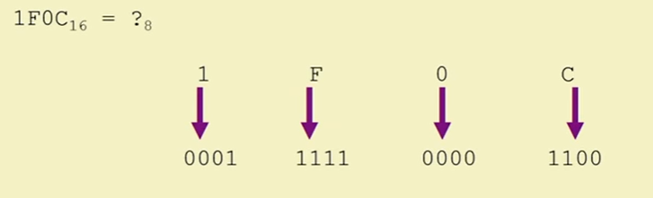
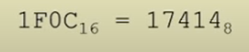
Hexadecimal to Octal
Use binary as intermediary

Slide 40
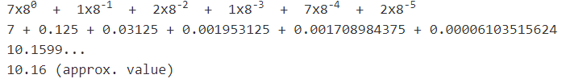
Question 1 Convert octal number 7.12172₍₈₎ into decimal form Solution:
7 | . | 1 | 2 | 1 | 7 | 2
Practice questions
Convert(234.701)₈ into (?)₁₀
Convert(123.001)₈ into (?)₁₀

Slide 41
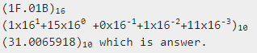
HEXADECIMAL TO DECIMAL Convert hexadecimal number 1F.01B into decimal number.
1 | F | . | 0 | 1 | B
Practice questions
Convert (204.ABC)₁₆ into (?)₁₀
Convert (300. DEF)₁₆ into (?)₁₀

Slide 42
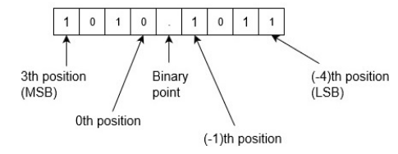
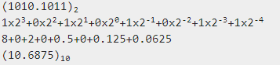
Question 1
Convert binary number 1010.1011 into decimal number.

Slide 43
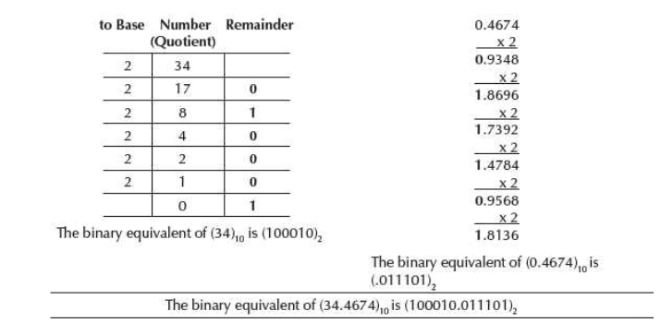
Question 1
Convert 34.4674 from Base 10 to Base 2.

Slide 44
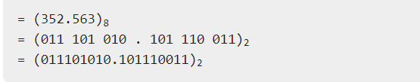
Question 2
Convert octal number 352.563 into binary number.

Slide 45
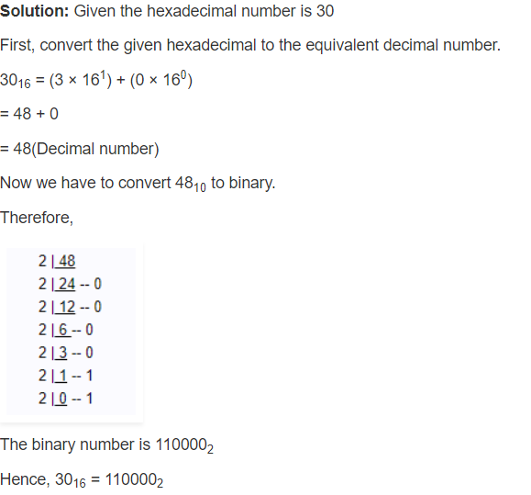
Question 3
Convert 30₁₆ to an equivalent binary number.

Slide 46

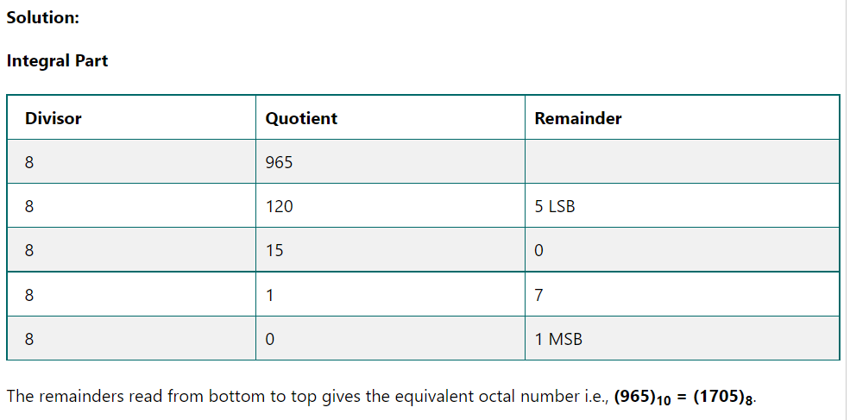
Question 4

Slide 47
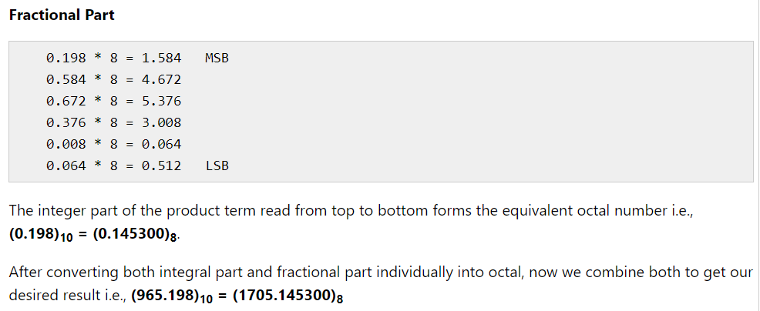
Question 4 (cont..)

Slide 48
Practice Question
.
Convert (0.345)10 into an octal number. | (0.16050)8 | (0.26050)8 | (0.19450)8 | (0.24040)8 | 2
The decimal equivalent of the binary number (1011.011)2 is ________ | (11.375)10 | (10.123)10 | (11.175)10 | (9.23)10 | 1
The binary representation of 22.5625 is: | 10010.1001 | 10110.1001 | 10101.101 | 10001.1101 | 2
(B9F.AE)16 =(?)8 | 5634.523 | 5673.892 | 5637.534 | 5234.754 | 3
Convert the binary number 1001.00102 to decimal. | 90.125 | 9.125 | 125 | 12.5 | 2
The following hexadecimal number (1E.43)16 is equivalent to | (36.506)8 | (36.206)8 | (35.506)8 | (35.206)8 | 2
Which is the same in octal, Hexadecimal, and decimal | 10 | 9 | 7 | 8 | 3
(0.23)10 is equivalent to | (0.166)8 | (0.165)8 | (0.185)8 | (0.105)8 | 2

Slide 49
.
BINARY ARITHEMATIC

Slide 50
Binary Addition Rules
1 + 1 = 0 with carry 1
1 + 0 = 1
0 + 1 = 1
0 + 0 = 0

Slide 51
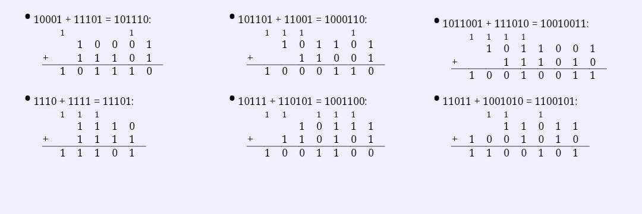
Binary Addition Examples

Slide 52
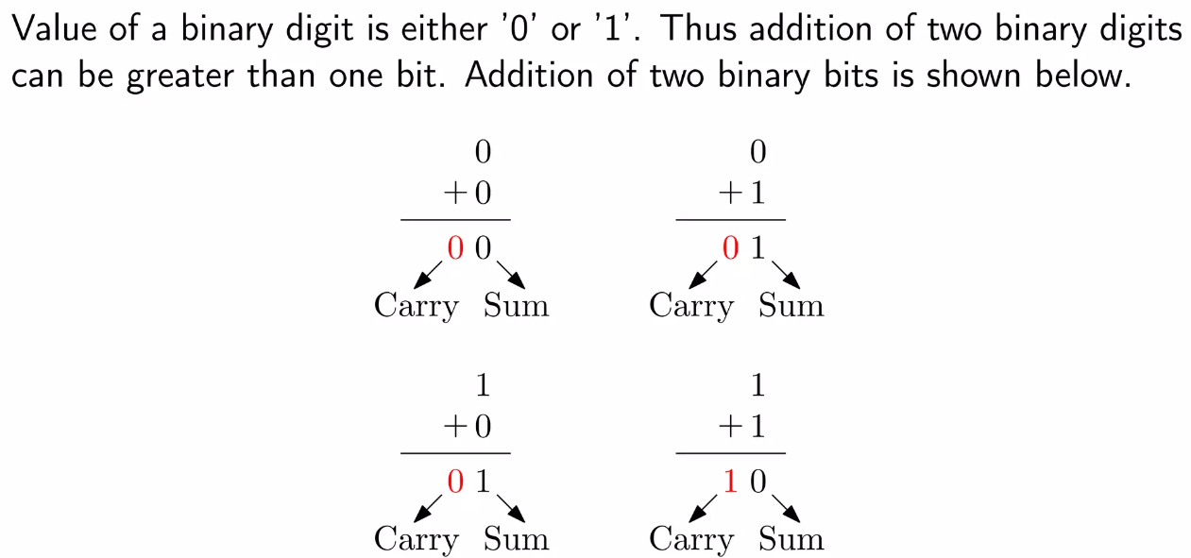
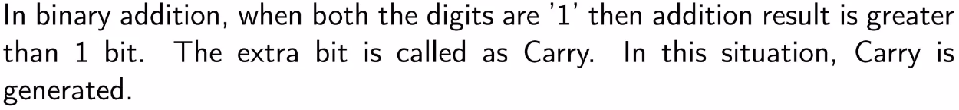
Binary Addition

Slide 53
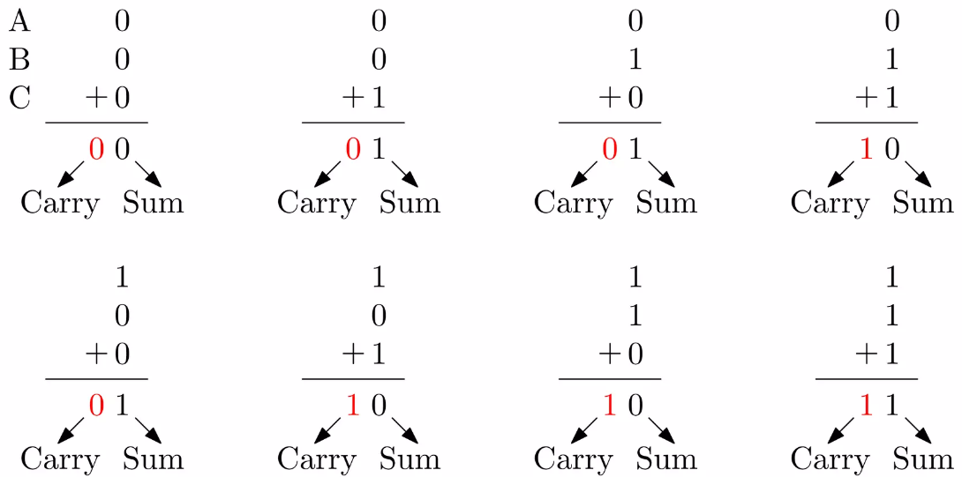
Addition of three bits

Slide 54
Binary Subtraction Rules
0 - 0 = 0
1 - 1 = 0
1 - 0 = 1
0 - 1 = 1 with borrow 1

Slide 55
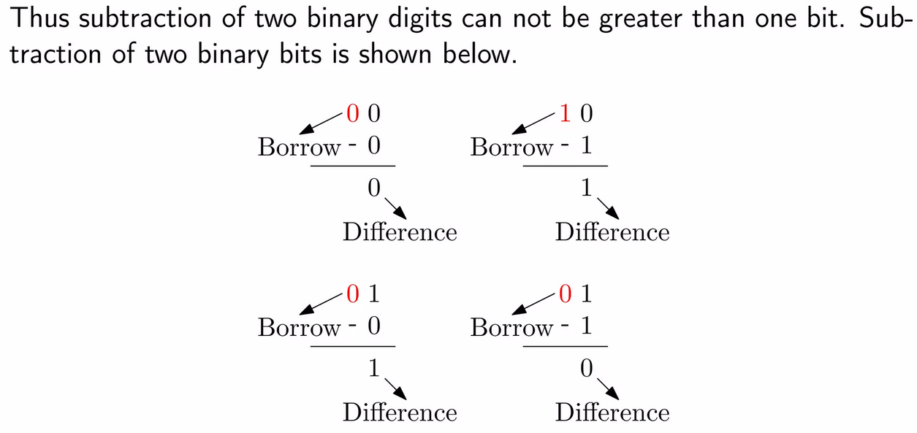
Binary Subtraction

Slide 56

Subtraction of three bits

Slide 57

Binary Subtraction Examples

Slide 58
Binary Multiplication Rules
1 × 1 = 1
1 × 0 = 0
0 × 1 = 0
0 × 0 = 0

Slide 59

Binary Multiplication

Slide 60
Binary Multiplication Example
1 0 1 0 0 1
× 1 1 0
________________
0 0 0 0 0 0
1 0 1 0 0 1
+ 1 0 1 0 0 1
_________________
1 1 1 1 0 1 1 0

Slide 61
Binary Division Rules
1 ÷ 1 = 1
1 ÷ 0 = 0
0 ÷ 1 = undefined
0 ÷ 0 = undefined

Slide 62

Binary Division Example

Slide 63
COMPLEMENTATION METHOD
COMPLEMENTATION METHOD

Slide 64

Complements of binary bits
To represent negative number in binary, we use mainly following methods:
1’s Complements
2’s Complements
Sign Magnitude
MSB=0 Positive Binary Number
MSB=1 Negative Binary Number

Slide 65

1’s Complement
In a given binary number if 1 is replaced by zero and zero is replaced by 1 then we get 1’s complement of that number.
E.g. :
(10011)
1’s complement is (01100)

Slide 66
2’s Complement
If we add 1 in 1’s complement then we get 2’s complement ie 1’s complement plus 1 is known as 2’s complement.
E.g. (10110)
Step 1:
Take 1’s complement of given number: 01001
Step 2:
2’s complement = 1’s complement + 1
= (01001 + 1)
= (01010)

Slide 67

Example
.

Slide 68
Practice Questions
. 1's compliment of 1's compliment of the binary number 0110110010011 is……?
2’s complement of 11001011 is __ | 1010111 | 11010100 | 110101 | 11100010 | 3

Slide 69
BIT, Byte, Nibble, Word
1 Bit=0 or 1
1Byte=8 bits
1 Nibble=4 bits
1 Word= 32 bits
Half-word=16 bits
Double Word=64 bits

Slide 70
.
LOGIC GATES

Slide 71
LOGIC GATES
It is an electronic or logic circuit having one or more then one inputs and only one output. Logic gates are the basic building blocks of any digital circuit.
There are three types of logic gates:
1. Basic gate
2. Universal gate
3. Special purpose gate

Slide 72
BASIC GATES
It is an electronic circuit which is used to perform basic operation is known as basic gate. There are three types of basic gates:
1. AND gate
2. OR gate
3. NOT gate

Slide 73

AND GATE
It is a basic gate which is used to perform AND (*) operation.
An AND gate has two or more inputs and a single output.
In this gate, the output is 1 when all the inputs are 1.
In other words, the output is high when all the inputs are high.
The most commonly used symbol for an AND gate is as shown with inputs A and B , output Y.

Slide 74

OR GATE
It is a basic gate which is used to perform OR(+) operation.
The OR gate is a digital logic gate with minimum 2 inputs and one output. The output of the OR gate is true only when one or more inputs are true.
If all the inputs of the gate are false, only then the output of the is false. The symbol and truth table of an OR gate with two inputs is shown.

Slide 75

NOT GATE
It is a basic gate which is used to perform NOT(complementation) operation.
The NOT gate is a digital logic gate with one input and one output that operates an inverter operation of the input.
The output of the NOT gate is the reverse of the input.
When the input of the NOT gate is true then the output will be false and vice versa.

Slide 76
.
PRACTICAL APPLICATIONS OF GATES

Slide 77

Practical Application of AND Gate
So while going out of the house you set the "Alarm Switch" and if the burglar enters he will set the "Person switch", and the alarm will ring.

Slide 78

Practical Application of OR Gate
You would of course want your doorbell to ring when someone presses either the front door switch or the back door switch.

Slide 79

Practical Application of NOT Gate
When the temperature falls below 20 degrees, the Not gate will set on the central heating system.

Slide 80
.
UNIVERSAL GATES

Slide 81
Universal Gates
NAND and NOR are known as universal gate because using either NAND or NOR we can implement all the three basic gates. There are two universal gates:
1. NAND Gate
2. NOR Gate

Slide 82

NAND GATE
It is a universal gate that is used to perform NAND (AND +NOT) operation.
The output of NAND gate is 1 when any one input or more than one input are 0.

Slide 83

NOR GATE
It is a universal gate that is used to perform NOR (OR+NOT) operation.
The output of NOR gate is 1 when all the inputs are 0.

Slide 84
Special Purpose Gates
X-OR and X-NOR are known as special purpose gate, because it is used in digital circuits to reduce hardware part of some digital circuits. There are two special types of special purpose gate
1. X-OR Gate
2. X-NOR Gate

Slide 85

EX-XOR GATE
It is a special purpose gate which is used to perform X OR operation.
XOR gate (sometimes EOR, or EX OR and pronounced as Exclusive OR) is a digital logic gate that gives a true (1 or HIGH) output when the number of true inputs is odd.
An XOR gate implements an exclusive or; that is, a true output results if one, and only one, of the inputs to the gate is true.
Y= AB’+A’B

Slide 86


EX-NOR GATE
It is a special purpose gate which is used to perform X - NOR operation.
Is a digital logic gate, that performs X-NOR operation that is the logical complement of the Exclusive OR (XOR) gate.

Slide 87
Boolean Algebra
Basic Theorems of Boolean Algebra

Slide 88
Boolean Algebra
T1 : Properties of 0
0 + A = A (b) 0 A = 0
T2 : Properties of 1
(a) 1 + A = 1 (b) 1 A = A

Slide 89
Boolean Algebra
T3 : Commutative Law
(a) A + B = B + A (b) A B = B A
T4 : Associate Law
(a) (A + B) + C = A + (B + C) (b) (A B) C = A (B C)
T5 : Distributive Law
(a) A (B + C) = A B + A C (b) A + (B C) = (A + B) (A + C)
(c) A+A’B = A+B

Slide 90
Boolean Algebra
T6 : Indempotence (Identity ) Law
(a) A + A = A (b) A A = A
T7 : Absorption (Redundance) Law
(a) A + A B = A (b) A (A + B) = A

Slide 91
Boolean Algebra
T8 : Complementary Law
(a) X+X’=1
(b) X.X’=0
T9 : Involution
(a) x’’ = x

Slide 92
.
De-Morgan’s Theorem

Slide 93



De-Morgan’s first theorem
It states that the complement of sum is equal to the product of their individual complements.

Slide 94



De-Morgan’s second theorem
It states that the complement of product is equal to the sum of their individual complements.

Slide 95


Examples
.

Slide 96


Example -2
.

Slide 97

Example-3
.

Slide 98


Boolean to Logic Gates
Converting Boolean expression to Logic Gates

Slide 99

Cont…
.

Slide 100


Example
.

Slide 101


Cont…
.

Slide 102

Example
.

Slide 103

Example
.

Slide 104

Example
.

Slide 105

Example
.

Slide 106


Example
.

Slide 107
Karnaugh Maps (K-Maps)
A Karnaugh map (K-Maps) is a graphical method used to obtained the most simplified form of an expression in a standard form (Sum-of-Products (SOP) or Product-of-Sums (POS)).
The simplest form of an expression is the one that has the minimum number of terms with the least number of literals (variables) in each term.
By simplifying an expression to the one that uses the minimum number of terms, we ensure that the function will be implemented with the minimum number of gates.

Slide 108

Two Variable K-Map
Two variable K Map is drawn for a Boolean expression consisting of two variables.
The number of cells present in two variable K Map = 2² = 4 cells.
So, for a Boolean function consisting of two variables, we draw a 2 x 2 K Map.
Here, A and B are the two variables of the given Boolean function.

Slide 109




Three Variable K-Map
Three variable K Map is drawn for a boolean expression consisting of three variables.
The number of cells present in three variable K Map = 2³ = 8 cells.
So, for a boolean function consisting of three variables, we draw a 2 x 4 K Map.
Here, A, B and C are the three variables of the given Boolean function.

Slide 110




Four Variable K-Map
Four variable K Map is drawn for a boolean expression consisting of four variables.
The number of cells present in four variable K Map = 2⁴ = 16 cells.
So, for a boolean function consisting of four variables, we draw a 4 x 4 K Map.
Here, A, B, C and D are the four variables of the given Boolean function.

Slide 111
SOP and POS
SOP (Sum of Product) Terms (Min Terms)
Y= A.B+C.D’
POS (Product of Sum) Terms (Max Terms)
Y= (A+B).(C+D’)

Slide 112

Example
.

Slide 113

2 variable grouping possibility
.

Slide 114

Example
.

Slide 115
Steps to solve expression using K-map
Select K-map according to the number of variables.
Identify minterms or maxterms as given in problem.
For SOP put 1’s in blocks of K-map respective to the minterms (0’s elsewhere).
For POS put 0’s in blocks of K-map respective to the maxterms(1’s elsewhere).
Make rectangular groups containing total terms in power of two like 2,4,8 ..(except 1) and try to cover as many elements as you can in one group.
From the groups made in step 5 find the product terms and sum them up for SOP form.
From the groups made in step 5 find the add terms and product them up for POS form.

Slide 116


SOP FORM : 1. K-map of 3 variables –
Z (A,B,C) = ∑(1,3,6,7)
From red group we get product term—
A’C
From green group we get product term—
AB
Summing these product terms we get- Final expression (A’C+AB)

Slide 117

Example
.

Slide 118

Example
.

Slide 119

Example
.

Slide 120

Example
.

Slide 121


2. K-map for 4 variables –
F(P,Q,R,S)=∑(0,2,5,7,8,10,13,15)
From red group we get product term—
QS
From green group we get product term—
Q’S’
Summing these product terms we get- Final expression (QS+Q’S’)

Slide 122


POS FORM : 1. K-map of 3 variables –
F(A,B,C)=π(0,3,6,7)
From red group we find terms
(A' + B')
From brown group we find terms
(B’+C’)
From yellow group we find terms
(A + B + C)
We will take product of these three terms : Final expression –
(A' + B’) (B’ + C’) (A + B + C)

Slide 123


2. K-map of 4 variables –
F(A,B,C,D)=π(3,5,7,8,10,11,12,13)
From green group we find terms
(C+D’+B’)
From red group we find terms
(C’+D’+A)
From blue group we find terms
(A’+C+D)
From brown group we find terms
(A’+B+C’)
Finally we express these as product –
(C+D’+B’).(C’+D’+A).(A’+C+D).(A’+B+C’)

Slide 124

Example
.

Slide 125

Example
.

Slide 126
Don’t Care Condition
The combinations for which the values of the expressions are not specified are called don’t care combination.
Represented in K-map by ‘X’

Slide 127

Example
.

Slide 128


Example
.

Slide 129


Example
Simplified Equation for K-map is

Slide 130


Example
The output expression for K-map is

Slide 131
Multiplexer, Demultiplexer, Latches and Flip-Flops

Slide 132
Multiplexer (Data Selectors)
The term Multiplexer means many into one.
Multiplexing is the process of transmitting a large number of information over a single line.
A Digital Multiplexer (MUX) is a combinational Circuit that select one digital information from several sources and transmits the selected information on a single output line.
A Multiplexer is also called a Data Selector.
The Multiplexer has several data input line and a single output line.

Slide 133
Multiplexer (Data Selectors)
MUX directs one of the inputs to its output line by using a control bit word (selection line) to its select lines.
Multiplexer contains the followings:
data inputs
selection inputs
a single output
Selection input determines the input that should be connected to the output.
The multiplexer acts like an electronic switch that selects one from different.

Slide 134


Block Diagram
MUX Types
→ 2-to-1 (1 select line)
→ 4-to-1 (2 select lines)
→ 8-to-1 (3 select lines)
→ 16-to-1 (4 select lines)

Slide 135

2 to 1 MUX

Slide 136

4-to-1 Multiplexer
D0
D1
D2
D3
MUX
Y
B A
B | A | Y
0 | 0 | D0
0 | 1 | D1
1 | 0 | D2
1 | 1 | D3

Slide 137
4-to-1 Multiplexer Waveform
D0
D1
D2
D3
A
B
Y
 | D0 | D1 | D2 | D3 | D0 | D1 | D2 | D3
Input
Data
Select
Line
Output
Data

Slide 138

Application

Slide 139



Examples

Slide 140

Example
Q. In following 1:4 MUX, what will be output if C1=1 and C0=0
Ans. M= X2

Slide 141

Example

Slide 142
Demultiplexer
The De-Multiplexer is a combinational logic circuit that performs the reverse operation of multiplexer (Several output lines, one input line).
De-Multiplexer means one to many. A De-Multiplexer is a circuit with one input and many output. By applying control signal, we can steer any input to the output. Few types of De -Multiplexer are 1-to 2, 1-to-4, 1-to-8 and 1-to 16 De-Multiplexer .
De-Multiplexer is the process of taking information from one input and transmitting the same over one of several outputs.

Slide 143

Block Diagram

Slide 144

1-to-4 Demultiplexer
D0
D1
D2
D3
X
DEMUX
B A
B | A | D0 | D1 | D2 | D3
0 | 0 | X | 0 | 0 | 0
0 | 1 | 0 | X | 0 | 0
1 | 0 | 0 | 0 | X | 0
1 | 1 | 0 | 0 | 0 | X

Slide 145
1-to-4 Demultiplexer Waveform
X
S0
S1
D0
D1
D2
D3
Input
Data
Select
Line
Output
Data

Slide 146

1:8 DEMUX

Slide 147

Application

Slide 148
Encoders and Decoders
.

Slide 149
Encoders
An encoder is a combinational circuit that converts binary information in the form of a 2^{N} input lines into N output lines, which represent N bit code for the input. For simple encoders, it is assumed that only one input line is active at a time.
As an example, let’s consider Octal to Binary encoder. As shown in the following figure, an octal-to-binary encoder takes 8 input lines and generates 3 output lines.

Slide 150

Octal to Binary Encoder (8 to 3 Encoder)
Truth Table –
D7 | D6 | D5 | D4 | D3 | D2 | D1 | D0 | X | Y | Z
0 | 0 | 0 | 0 | 0 | 0 | 0 | 1 | 0 | 0 | 0
0 | 0 | 0 | 0 | 0 | 0 | 1 | 0 | 0 | 0 | 1
0 | 0 | 0 | 0 | 0 | 1 | 0 | 0 | 0 | 1 | 0
0 | 0 | 0 | 0 | 1 | 0 | 0 | 0 | 0 | 1 | 1
0 | 0 | 0 | 1 | 0 | 0 | 0 | 0 | 1 | 0 | 0
0 | 0 | 1 | 0 | 0 | 0 | 0 | 0 | 1 | 0 | 1
0 | 1 | 0 | 0 | 0 | 0 | 0 | 0 | 1 | 1 | 0
1 | 0 | 0 | 0 | 0 | 0 | 0 | 0 | 1 | 1 | 1
As seen from the truth table, the output is 000 when D0 is active; 001 when D1 is active; 010 when D2 is active and so on.

Slide 151

Implementation…
From the truth table, the output line Z is active when the input octal digit is 1, 3, 5 or 7. Similarly, Y is 1 when input octal digit is 2, 3, 6 or 7 and X is 1 for input octal digits 4, 5, 6 or 7. Hence, the Boolean functions would be:
X = D4 + D5 + D6 + D7
Y = D2 +D3 + D6 + D7
Z = D1 + D3 + D5 + D7
Hence, the encoder can be realized with OR gates as follows:

Slide 152

Decimal to BCD Encoder
The decimal-to-binary encoder usually consists of 10 input lines and 4 output lines. Each input line corresponds to each decimal digit and 4 outputs correspond to the BCD code. This encoder accepts the decoded decimal data as an input and encodes it to the BCD output which is available on the output lines. The figure below shows the logic symbol of the decimal to BCD encoder

Slide 153
Decimal to BCD Encoder
The truth table for decimal to BCD encoder is as follows.
INPUTS |  |  |  |  |  |  |  |  |  | OUTPUTS
Y9 | Y8 | Y7 | Y6 | Y5 | Y4 | Y3 | Y2 | Y1 | Y0 | A3 | A2 | A1 | A0
0 | 0 | 0 | 0 | 0 | 0 | 0 | 0 | 0 | 1 | 0 | 0 | 0 | 0
0 | 0 | 0 | 0 | 0 | 0 | 0 | 0 | 1 | 0 | 0 | 0 | 0 | 1
0 | 0 | 0 | 0 | 0 | 0 | 0 | 1 | 0 | 0 | 0 | 0 | 1 | 0
0 | 0 | 0 | 0 | 0 | 0 | 1 | 0 | 0 | 0 | 0 | 0 | 1 | 1
0 | 0 | 0 | 0 | 0 | 1 | 0 | 0 | 0 | 0 | 0 | 1 | 0 | 0
0 | 0 | 0 | 0 | 1 | 0 | 0 | 0 | 0 | 0 | 0 | 1 | 0 | 1
0 | 0 | 0 | 1 | 0 | 0 | 0 | 0 | 0 | 0 | 0 | 1 | 1 | 0
0 | 0 | 1 | 0 | 0 | 0 | 0 | 0 | 0 | 0 | 0 | 1 | 1 | 1
0 | 1 | 0 | 0 | 0 | 0 | 0 | 0 | 0 | 0 | 1 | 0 | 0 | 0
1 | 0 | 0 | 0 | 0 | 0 | 0 | 0 | 0 | 0 | 1 | 0 | 0 | 1

Slide 154

Cont…
Logical expression for A3, A2, A1, and A0.
A3 = Y9 + Y8
A2 = Y7 + Y6 + Y5 +Y4
A1 = Y7 + Y6 + Y3 +Y2
A0 = Y9 + Y7 +Y5 +Y3 + Y1

Slide 155
2. Decoders –
A decoder does the opposite job of an encoder. It is a combinational circuit that converts n lines of input into 2^{n} lines of output. Let’s take an example of 3-to-8 line decoder.
Truth Table –
X | Y | Z | D0 | D1 | D2 | D3 | D4 | D5 | D6 | D7
0 | 0 | 0 | 1 | 0 | 0 | 0 | 0 | 0 | 0 | 0
0 | 0 | 1 | 0 | 1 | 0 | 0 | 0 | 0 | 0 | 0
0 | 1 | 0 | 0 | 0 | 1 | 0 | 0 | 0 | 0 | 0
0 | 1 | 1 | 0 | 0 | 0 | 1 | 0 | 0 | 0 | 0
1 | 0 | 0 | 0 | 0 | 0 | 0 | 1 | 0 | 0 | 0
1 | 0 | 1 | 0 | 0 | 0 | 0 | 0 | 1 | 0 | 0
1 | 1 | 0 | 0 | 0 | 0 | 0 | 0 | 0 | 1 | 0
1 | 1 | 1 | 0 | 0 | 0 | 0 | 0 | 0 | 0 | 1

Slide 156

Implementation..
D0 is high when X = 0, Y = 0 and Z = 0. Hence,
D0 = X’ Y’ Z’ Similarly,
D1 = X’ Y’ Z D2 = X’ Y Z’ D3 = X’ Y Z D4 = X Y’Z’
D5 = X Y’ Z D6 = X Y Z’ D7 = X Y Z Hence,

Slide 157
BCD to 7 Segment Decoder
In Binary Coded Decimal (BCD) encoding scheme each of the decimal numbers(0-9) is represented by its equivalent binary pattern(which is generally of 4-bits).
Whereas, Seven segment display is an electronic device which consists of seven Light Emitting Diodes (LEDs) arranged in a some definite pattern (common cathode or common anode type), which is used to display Hexadecimal numerals(in this case decimal numbers, as input is BCD i.e., 0-9).

Slide 158
Seven Segment LED Display
Two types of seven segment LED display:
Common Cathode Type: In this type of display all cathodes of the seven LEDs are connected together to the ground or –Vcc (hence, common cathode) and LED displays digits when some ‘HIGH’ signal is supplied to the individual anodes.
Common Anode Type: In this type of display all the anodes of the seven LEDs are connected to battery or +Vcc and LED displays digits when some ‘LOW’ signal is supplied to the individual cathodes.

Slide 159
Cont…
But, seven segment display does not work by directly supplying voltage to different segments of LEDs. First, our decimal number is changed to its BCD equivalent signal then BCD to seven segment decoder converts that signals to the form which is fed to seven segment display.
This BCD to seven segment decoder has four input lines (A, B, C and D) and 7 output lines (a, b, c, d, e, f and g), this output is given to seven segment LED display which displays the decimal number depending upon inputs.

Slide 160

Conti…

Slide 161

Cont..
Truth Table – For common cathode type BCD to seven segment decoder:

Slide 162
Cont…
Note –
For Common Anode type seven segment LED display, we only have to interchange all ‘0s’ and ‘1s’ in the output side i.e., (for a, b, c, d, e, f, and g replace all ‘1’ by ‘0’ and vice versa) and solve using K-map.
Output for first combination of inputs (A, B, C and D) in Truth Table corresponds to ‘0’ and last combination corresponds to ‘9’. Similarly rest corresponds from 2 to 8 from top to bottom.
BCD numbers only range from 0 to 9,thus rest inputs from 10-F are invalid inputs.

Slide 163

Cont…
Example –

Slide 164
Cont…
Explanation For combination where all the inputs (A, B, C and D) are zero (see Truth Table), our output lines are a = 1, b = 1, c = 1, d = 1, e = 1, f = 1 and g = 0. So 7 segment display shows ‘zero’ as output. Similarly, for combination where one of the input is one (D = 1) and rest are zero, our output lines are a = 0, b = 1, c = 1, d = 0, e = 0, f = 0 and g = 0. So only LEDs ‘b’ and ‘c’ (see diagram above) will glow and 7 segment display shows ‘one’ as output.

Slide 165
Latches and Flip Flops
.

Slide 166

Introduction
A sequential circuit consists of a feedback path, and employs some memory elements.
Combinational outputs
Memory outputs
Combinational logic
Memory elements
External inputs
Sequential circuit = Combinational logic + Memory Elements

Slide 167
Introduction
There are two types of sequential circuits:
synchronous: outputs change only at specific time
asynchronous: outputs change at any time
Multivibrator: a class of sequential circuits. They can be:
bistable (2 stable states)
monostable or one-shot (1 stable state)
astable (no stable state)
Bistable logic devices: latches and flip-flops.
Latches and flip-flops differ in the method used for changing their state.

Slide 168
Memory Elements
Memory element: a device which can remember value indefinitely, or change value on command from its inputs.
Characteristic table:
Memory element
Q
command
stored value
Q(t): current state
Q(t+1) or Q⁺: next state

Slide 169
Memory Elements
Two types of triggering/activation:
pulse-triggered
edge-triggered
Pulse-triggered
latches
ON = 1, OFF = 0
Edge-triggered
flip-flops
positive edge-triggered (ON = from 0 to 1; OFF = other time)
negative edge-triggered (ON = from 1 to 0; OFF = other time)

Slide 170
S-R Latch
Complementary outputs: Q and Q'.
When Q is HIGH, the latch is in SET state.
When Q is LOW, the latch is in RESET state.
For active-HIGH input S-R latch (also known as NOR gate latch),
R=HIGH (and S=LOW) a RESET state
S=HIGH (and R=LOW) a SET state
both inputs LOW a no change
both inputs HIGH a Q and Q' both LOW (invalid)!

Slide 171
S-R Latch
Characteristics table for active-high input S-R latch:
S
R
Q
Q'

Slide 172
S-R Latch
Active-HIGH input S-R latch
1
0
1
0
0
1
1
0
0
R
Q
0
Q'
0
0
1
1
1
S
0
0
0
0
1

Slide 173
Gated D Latch
Make R input equal to S' → gated D latch.
D latch eliminates the undesirable condition of invalid state in the S-R latch.
D
Q
D
EN
Q
Q'
EN
Q'

Slide 174
Gated D Latch
When EN is HIGH,
D=HIGH → latch is SET
D=LOW → latch is RESET
Hence when EN is HIGH, Q ‘follows’ the D (data) input.
Characteristic table:
When EN=1, Q(t+1) = D

Slide 175
Latch Circuits: Not Suitable
Latch circuits are not suitable in synchronous logic circuits.
When the enable signal is active, the excitation inputs are gated directly to the output Q. Thus, any change in the excitation input immediately causes a change in the latch output.
The problem is solved by using a special timing control signal called a clock to restrict the times at which the states of the memory elements may change.
This leads us to the edge-triggered memory elements called flip-flops.

Slide 176
Edge-Triggered Flip-flops
Flip-flops: synchronous bistable devices
Output changes state at a specified point on a triggering input called the clock.
Change state either at the positive edge (rising edge) or at the negative edge (falling edge) of the clock signal.
Clock signal
Positive edges
Negative edges

Slide 177

Types of Flip Flops

Slide 178

S-R Flip-flop
S-R flip-flop: on the triggering edge of the clock pulse,
S=HIGH (and R=LOW) a SET state
R=HIGH (and S=LOW) a RESET state
both inputs LOW a no change
both inputs HIGH a invalid

Slide 179
S-R Flip-flop
It comprises 3 parts:
a basic NAND latch
a pulse-steering circuit
a pulse transition detector (or edge detector) circuit
The pulse transition detector detects a rising (or falling) edge and produces a very short-duration spike.

Slide 180

SR Flip Flop using NAND Gate
SR Flip Flop using NAND Gate

Slide 181


Characteristic Table (SR FF)
Excitation Table

Slide 182

Cont…
Logic Symbol of SR Flip Flop

Slide 183
D Flip-flop
D flip-flop: single input D (data)
D=HIGH a SET state
D=LOW a RESET state
Q follows D at the clock edge.
Convert S-R flip-flop into a D flip-flop: add an inverter.
D
S
C
R
Q
Q'
CLK
↑ = clock transition LOW to HIGH
A positive edge-triggered D flip-flop formed with an S-R flip-flop.

Slide 184


D FF

Slide 185

Characteristic Table
Characteristic Table- D Flip Flop

Slide 186
J-K Flip-flop
J-K flip-flop: Q and Q' are fed back to the pulse-steering NAND gates.
No invalid state.
Include a toggle state.
J=HIGH (and K=LOW) a SET state
K=HIGH (and J=LOW) a RESET state
both inputs LOW a no change
both inputs HIGH a toggle

Slide 187

JK Flip Flop

Slide 188

Characteristic Table- JK Flip Flop
Characteristic Table- JK Flip Flop

Slide 189


Logical Symbol and excitation Table
Logical Symbol and excitation Table

Slide 190

T Flip Flop
T Flip Flop
In T flip flop, "T" defines the term "Toggle".

Slide 191

Cont…

Slide 192

Characteristic Table- T Flip Flop
Characteristic Table- T Flip Flop

Slide 193
.
Thank You!

